Slide 1

BOOK CROSSING
Talia Cohen
Hagay Shkoory
Ella Avraham Korob

Slide 2

DATA SOURCE

Slide 3
Our dataset is based on a book survey that was collected by Cai-Nicolas Ziegler from the Book-Crossing community with kind permission from Ron Hombaker, CTO at Humanking System.
The data set contains three files:
User information (User-ID, age, and geographic information such as region, city, and country).
Book Description (ISBN [Book-ID], book title, author name, year of publication, publisher name, and book images)
Book rating (User-ID, ISBN [Book-ID], book-rating).
Using Python’s “PySpark” library for data cleansing and transforming the data frames into a star schema model (Dim_Users, Dim_Books, and Fact_Ratings tables).

Slide 4
GENERATING DATAFRAMES

Slide 5

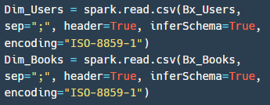
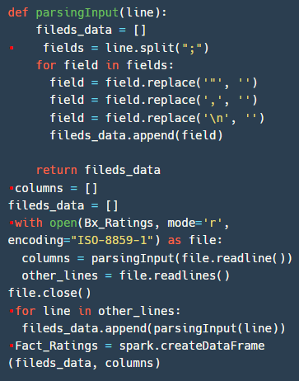
01
02
Description
Generated Dim tables by defining the delimiter is (;).
The Fact_Ratings data file contained malformed data with various of separators inside, which caused the data to be imported without the correct columns (columns were merged). Parsing the data through a function that replaces the incorrect separator to generate the table with the correct columns separation.
Code

Slide 6
DIM_USERS

Slide 7
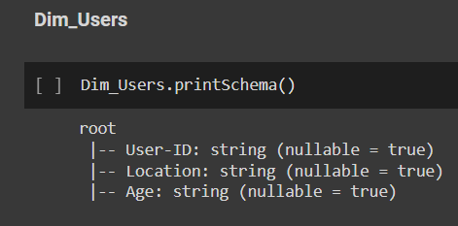
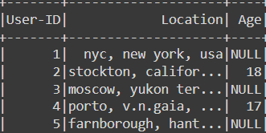
01
02
Description
Checked the schema of the Dim_ users data frame and found that user-id and age were defined as string type instead of numerical
Overview of Dim_Users data frame
Detecting null values in the age column and found that the location column contains city country and region information
Code
Results

Slide 8
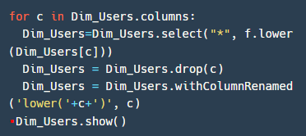
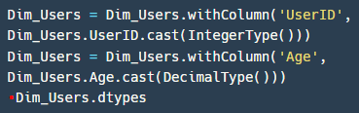
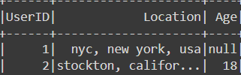
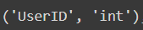
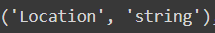
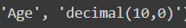
03
04
Description
Converted the data frame columns to lowercase to have homogeneity data for data cleansing
Converted the data type of UserID and age columns to numerical
Code
Results

Slide 9
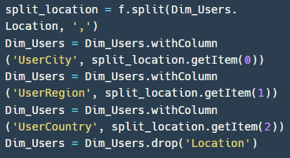
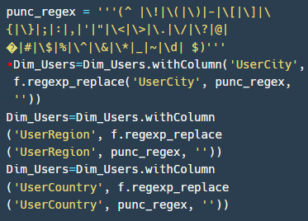
05
06
Description
Split the Location column into three columns:
UserCity
UserRegion
UserCountry
Dropped the Location column
Removed punctuation
from the new columns that created from the Location
In order to have homogeneity data of location
Code

Slide 10
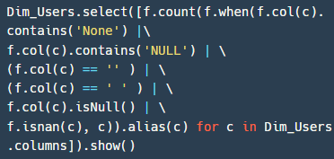
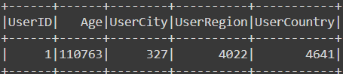
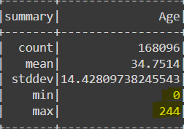
07
08
Description
Find rows which has cells with a null value and empty cells in all columns
Checked Dim_Users age column statistics, resulting the min age is 0 and max age is 244. Meaning the age column contains malformed data and values.
Code
Results

Slide 11
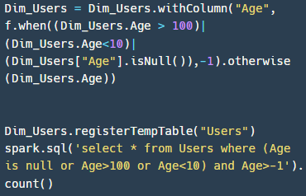
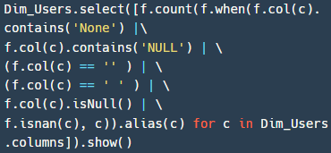
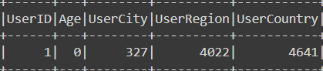
09
10
Description
Updated the age column for users that contain above 100, below 10, and null values to -1.
Verified the transformation is correct.
Checked for null values in Dim_Users – results:
UserID - 1 row
UserCity - 327 rows
UserRegion – 4,022 rows
UserCountry – 4,641 rows
Code
Results

Slide 12
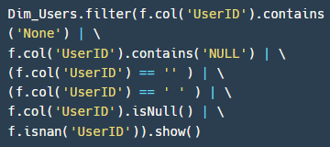
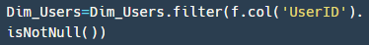
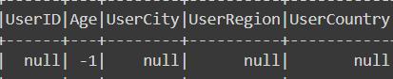
11
12
Description
Detected the row that contains null in the UserID column.
Dropped the row that contains null in UserID since the entire row contains null values.
Code
Results

Slide 13
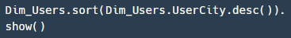
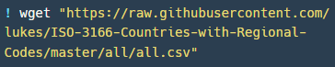
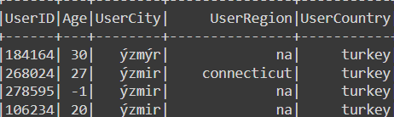
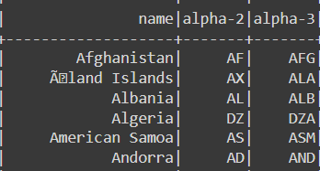
13
14
Imported a countries file from GitHub with data of correct country names.
UserCountry data cleansing required the following columns from the imported file:
Alpha 2 code (e.g. “AF”), Alpha 3 code (e.g. “AFG”), Name (e.g. “Afghanistan”)
Converted the file into a data frame, named “countries”, and changed it to lower case to match the UserCountry column.
Description
Sorted the data frame by UserCity column in order to visually check the unusable values.
Find unusable values in UserCity and UserRegion such as “na”, empty cells, etc., and replace them with ‘unknown’.
Find that the UserCountry column contains different forms of country names (e.g. “united states” can appear as “us”)
Code
Results

Slide 14
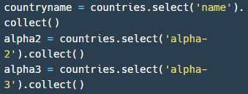
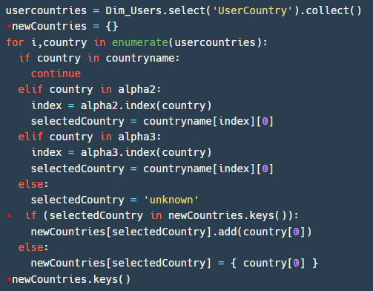
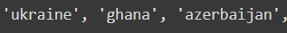
15
16
Description
Generated lists from countries data frame columns in order to use the lists with a loop in the following steps.
Generated a dictionary with correct countries as keys (using the lists from step 15) and values with related values from UserCountry (e.g. key: “united states”, values: “us”, “usa”).
Code
Results

Slide 15
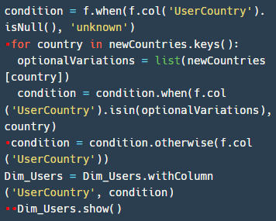
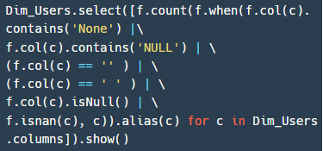
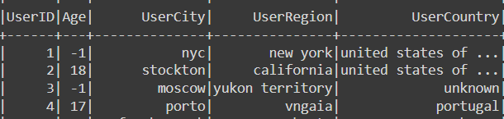
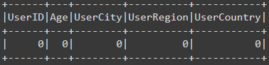
17
18
Description
Replaced UserCountry incorrect values
with the keys of the newCountries dictionary.
After the data update, checked the number of users with unknown countries - a total of 26,837 (10% of all users).
Verified that all empty cells and null values were handled.
Code
Results

Slide 16
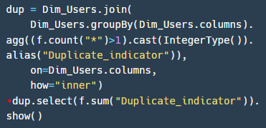
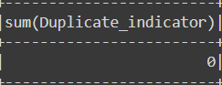
19
Description
Checked if there are duplicate users in Dim_Users data frame.
No duplicates were found.
Code
Results

Slide 17
DIM_BOOKS

Slide 18
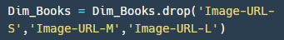
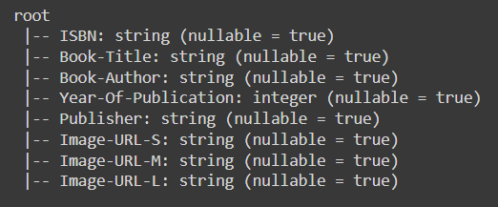
01
02
Description
Checked the schema of the Dim_ Books data frame.
All data types in Dim_Books are correct.
Dropped unnecessary columns (Book images) for analysis.
Code
Results

Slide 19
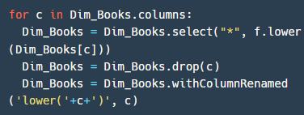
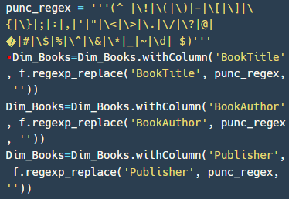
03
04
Description
Converted the data frame columns to lowercase to have homogeneity data for data cleansing.
After converting it to lowercase, the data type of the ” YearOfPublication” column changed to a string. Therefore, we transformed it back to an integer.
Removed punctuation
from the following columns:
BookTitle
BookAuthor
Publisher
To have homogeneity data in the Dim_Books table.
Code

Slide 20
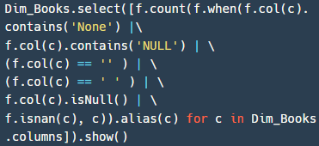
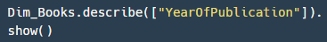
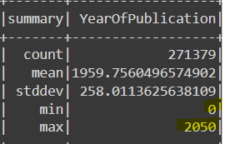
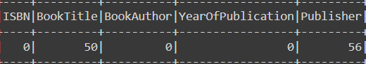
05
06
Description
Find cells with a null value or empty
in all columns. The following columns have been found with missing values:
Book Title - 50 values.
Publisher – 56 values.
Replaced missing values with ‘unknown’.
Checked Dim_Users age column statistics, resulting the min age is 0 and max age is 244. Checked Dim_Books YearOfPublication column statistics, resulting the min YearOfPublication is 0 and max YearOfPublication is 2050. Meaning the YearOfPublication column contains
malformed data and values. Updated the YearOfPublication column for books that contain value equal to 0 or above 2022, to 1900.
Meaning the age column contains malformed data and values.
Code
Results

Slide 21
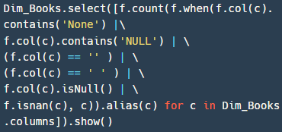
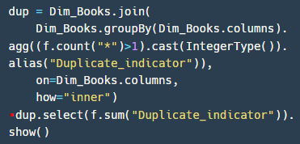
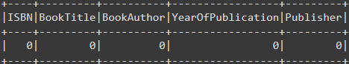
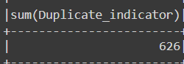
07
08
Description
Verified that all empty cells and null values were handled.
Checked if there are duplicate books in Dim_Books data frame.
626 duplicated rows were found.
Code
Results

Slide 22
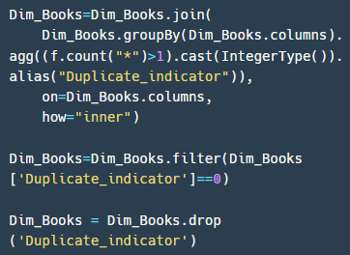
09
Description
The "Duplicate indicator" was added as a column to indicate whether a row is duplicated or not (0=no, 1=yes)
Filtered and removed the 1 value rows out of Dim_Books.
After dealing with the duplicated values, the "Duplicate indicator" column was removed.
Code

Slide 23
FACT_RATINGS

Slide 24
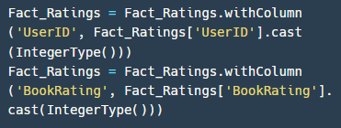
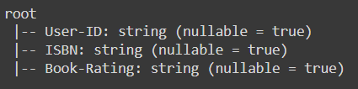
01
02
Description
Checked the schema of the Fact_Ratings data frame.
Find that the User-ID and Book-Rating columns are string type instead of numerical type
Converted data types of UserID and BookRating columns to numerical types.
Code
Results

Slide 25
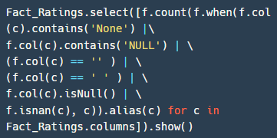



03
04
Description
Checked for null values or empty cells in all columns.
No missing values were found.
Sorted the data frame by UserID column to visually check for unusable values.
Code
Results

Slide 26


05
Description
Checked if there are duplicate users in the Fact_Ratings data frame.
No duplicates were found.
Code
Results

Slide 27
EXPORTING
DIM & FACT TABLES

Slide 28

01
Description
Generated CSV files for each data frame and exported them to a new folder in google drive after verifying that those files do not exist in the folder.
Code

Slide 29
CONCLUSIONS

Slide 30

BOOKS AVERAGE RATINGS
not including books that rated below 10 times
The table presents the average rating of top-rated books.

Slide 31
USERS, BOOKS & RATINGS
The dashboard on the next slide displays three visualizations – top-rated books, top-rated authors, and book readers map per country.
For example, the top-rated book in the United States is “There’s treasure everywhere a Calvin and hobbes collection” with an average rating of 9.182, written by the author Bill Watterson.
The top-rated author Virginia Beard Morton with the highest rate of 8.2 in the United States.
We can notice that the books of the author Rich Shapero are top-rated in many countries such as Austria (1.83), Brazil (0.4), Malaysia (1.09), Netherlands (0.36), New Zealand (1.35), and Singapore (1.25).

Slide 32


Slide 33
USERS' AVERAGE AGE, PUBLISHERS & RATINGS
The dashboard on the next slide displays two visualizations – users’ average age per country and top-rated publisher.
For example, the average age of the readers in Afghanistan is 27.3 years old.
With 15 book ratings, the publisher "Edgehill Books" scored the highest average book rating (8).

Slide 34


Slide 35

THANK YOU

